Slide 1


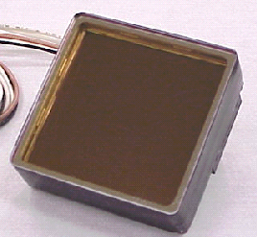
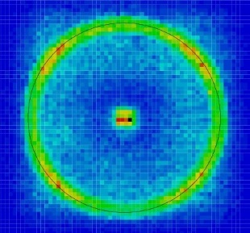

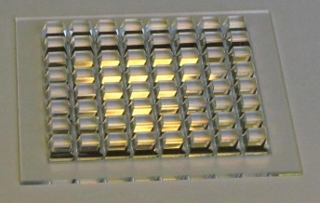
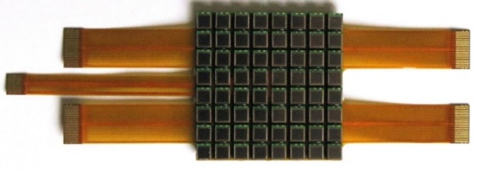
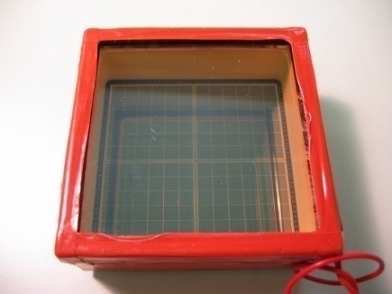


Novel photon detectors
Peter Križan
University of Ljubljana and J. Stefan Institute

Slide 2
Introduction: why?
Photon detectors are at the heart of most experiments in particle and nuclear physics. Moreover, they are also finding applications in other scientific fields (chemistry and biology) and are ubiquitous in society in general.
New environments where we need to detect light (in particular low light levels) → need advances in existing technology and transformative, novel ideas to meet the demanding requirements.
Two main lines of R&D to be pursued have been identified by the ECFA Detector R&D Roadmap:
- Enhance timing resolution and spectral range of photon detectors.
- Develop photosensors for extreme environments.
This talk: photosensors will be discussed in this spirit; also: the main emphasis will be on low light level detection.

Slide 3
Contents
Introduction: why and what kind of photosensor?
Vacuum-based photodetectors
Solid state low light level photosensors
Gas-based photodetectors
Summary and outlook

Slide 4
Vacuum-based photodetectors
Generic steps:
Photon → photoelectron conversion
Photoelectron collection in the multiplication system
Mutiplication (dynodes, microchannel plates, high E field + Si)
Signal collection

Slide 5
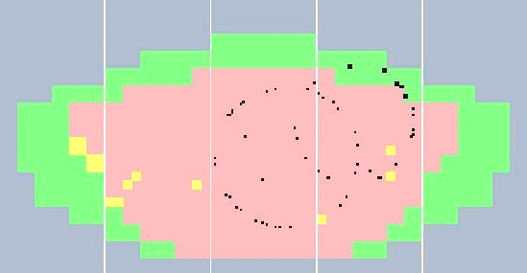
Multianode photomultiplier tubes (PMTs)
Response to single photons
Metal channel dynodes
Pioneered in the HERA-B RICH, later used in
RICH detectors of COMPASS, CLASS12 and GlueX
Recent use in the upgraded LHCb RICH detectors;
planned for CBM RICH
Excellent performance (excellent single photon detection efficiency, very low noise, low cross-talk), best choice for large areas with no B field

Slide 6
Micro Channel Plate PMT (MCP-PMT)
Multiplication step: a continuous dynode – a micro-channel

Slide 7
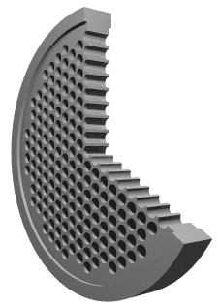

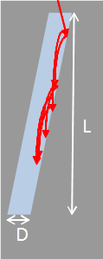

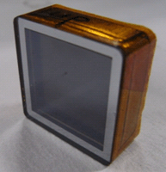
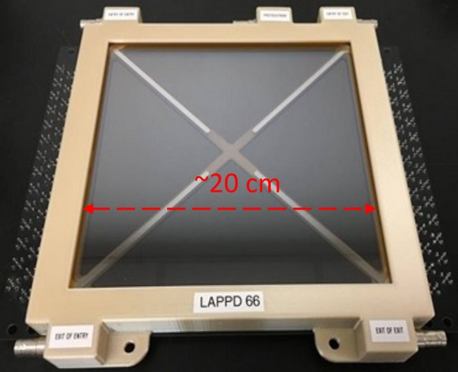
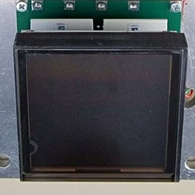
Micro Channel Plate PMT (MCP-PMT)
Similar to ordinary PMT – the dynode structure is replaced by MCPs.
Basic characteristics:
Gain ~ 10⁶ → single photon
Collection efficiency ~ 60%
Small thickness, high field → small TTS
Works in magnetic field
Segmented anode
→ position sensitive
MCP is a thin glass plate with an array of holes (<10-100 μm diameter) - - a continuous dynode structure
Φ ~ 10 μm
~ 400 μm
window with photocathode
dual MCP -
Chevron config.
Anodes → can be segmented according to application needs
HAMAMATSU
MCP gain depends on L/D ratio – typically 1000 for L/D=40
PHOTONIS
PHOTEK
LAPPD

Slide 8
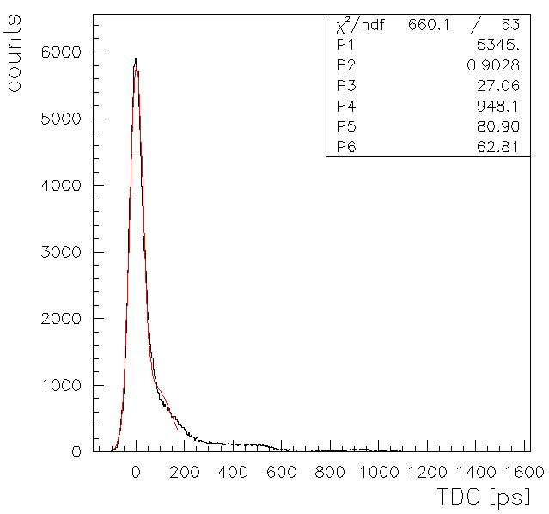

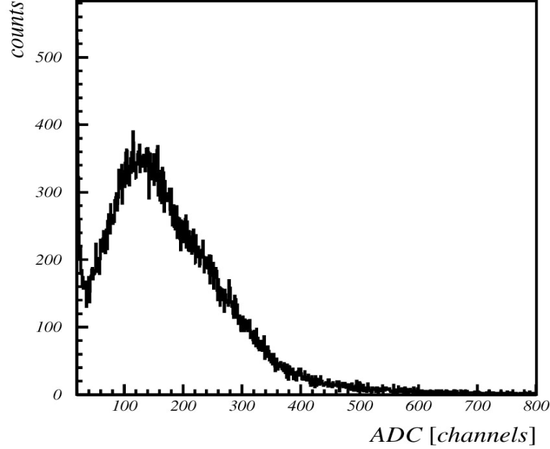


MCP-PMT: single photon pulse height and timing
Typical single photon timing distribution with a narrow main peak (σ ~ 40 ps) and contributions from photoelectron elastic (flat distribution) and inelastic back-scattering.
Photoelectron back-scattering produces a rather long tail in timing distribution and position resolution.
Photoelectron backscattering reduces collection efficiency and gain, and contributes to cross-talk in multi-anode PMTs
Gain in a single channel saturates at high gains due to space charge effect → peaking distribution for single photoelectrons
S.Korpar, talk at PD07

Slide 9
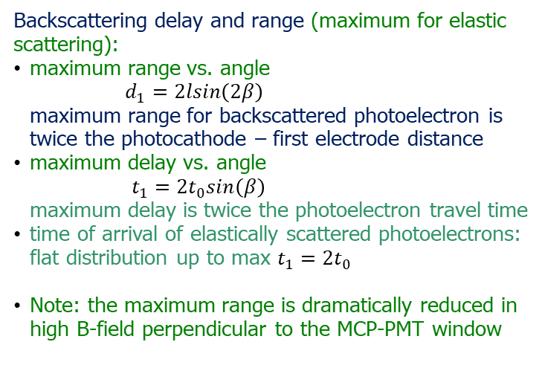
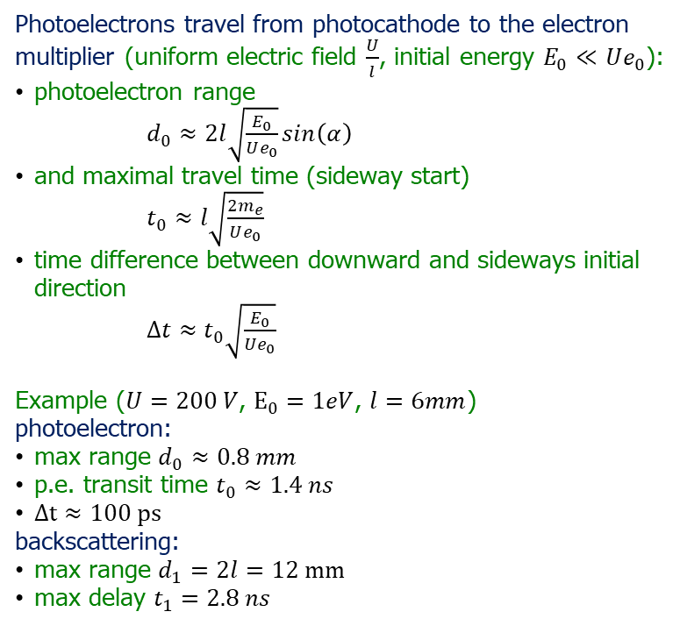

Photoelectron in uniform electric field
$$d_{0}$$
$$d_{1}$$
Photoelectrons travel from photocathode to the electron multiplier (uniform electric field $\frac{U}{l}$, initial energy $E_{0}≪Ue_{0}$):
photoelectron range
$d_{0}≈2l\sqrt{\frac{E_{0}}{Ue_{0}}}sin\left(α\right)$
and maximal travel time (sideway start)
$t_{0}≈l\sqrt{\frac{2m_{e}}{Ue_{0}}}$
time difference between downward and sideways initial direction
$Δt≈t_{0}\sqrt{\frac{E_{0}}{Ue_{0}}}$
Example ($U=200 V$, $E_{0}=1eV$, $l=6mm$)
photoelectron:
max range $d_{0}≈0.8 mm$
p.e. transit time $t_{0}≈1.4 ns$
$Δt≈100 ps$
backscattering:
max range $d_{1}=2l=12 mm$
max delay $t_{1}=2.8 ns$
$$γ$$
window with photocathode
$$U$$
$$α$$
$$e^{−}$$
$$l$$
$$β$$
MCP1
Backscattering delay and range (maximum for elastic scattering):
maximum range vs. angle
$d_{1}=2lsin\left(2β\right)$
maximum range for backscattered photoelectron is twice the photocathode – first electrode distance
maximum delay vs. angle
$t_{1}=2t_{0}sin\left(β\right)$
maximum delay is twice the photoelectron travel time
time of arrival of elastically scattered photoelectrons: flat distribution up to max $t_{1}=2t_{0}$
Note: the maximum range is dramatically reduced in high B-field perpendicular to the MCP-PMT window
S. Korpar, Talk at PD07

Slide 10
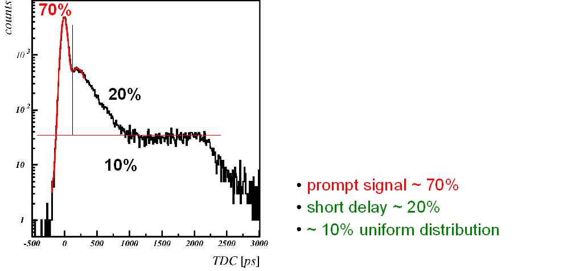
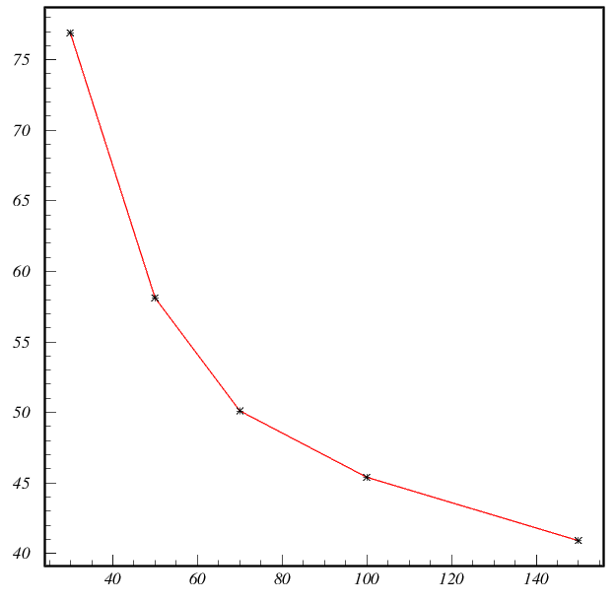

MCP PMT modeling
Tails understood (elastic and inelastic scattering of photoelectrons off the MCP), can be significantly reduced by:
decreased photocathode-MCP distance and
increased photocathode-MCP voltage difference
σ(ps)
Timing: Expect to improve with increased photocathode-MCP voltage difference as sqrt(HV_{PC-MCP1})
MCP-PMT LAPPD – timing vs PC-MCP1 voltage →

Slide 11
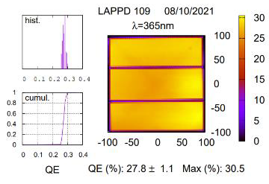
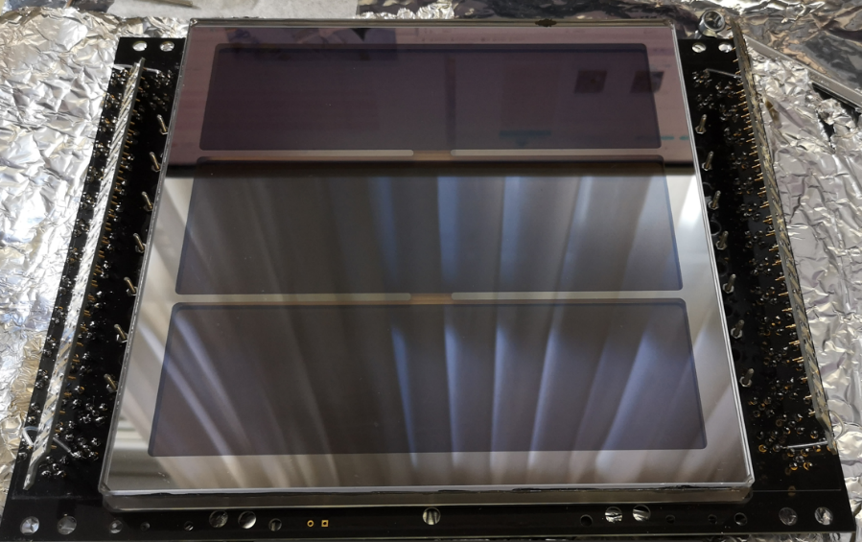
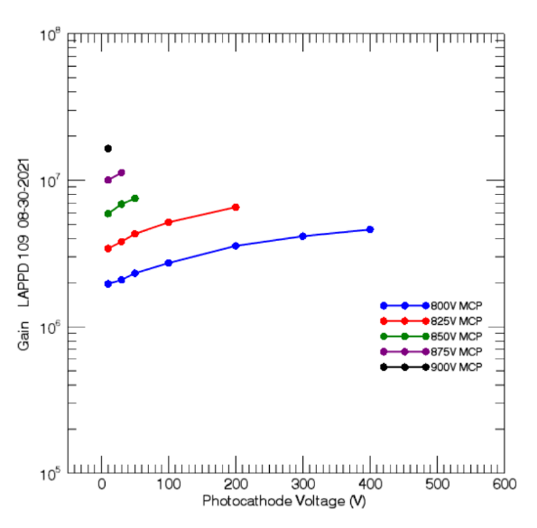
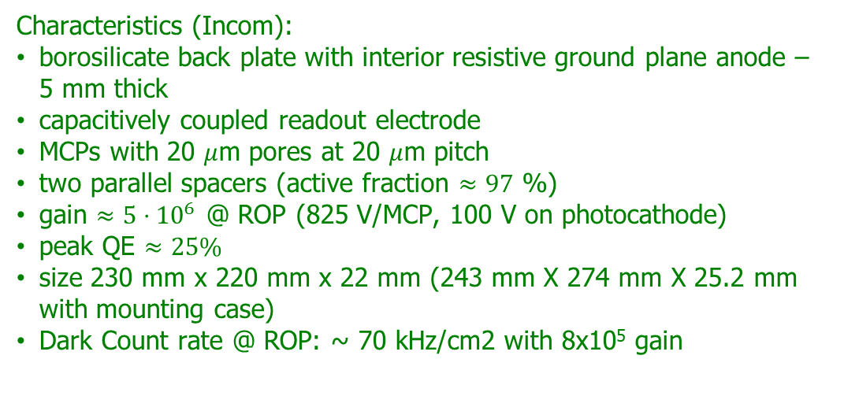
LAPPD (large area picosecond photodetector) Gen II
Characteristics (Incom):
borosilicate back plate with interior resistive ground plane anode – 5 mm thick
capacitively coupled readout electrode
MCPs with 20 $μ$m pores at 20 $μ$m pitch
two parallel spacers (active fraction $≈97$ %)
gain $≈5⋅{10}^{6}$ @ ROP (825 V/MCP, 100 V on photocathode)
peak QE $≈25\%$
size 230 mm x 220 mm x 22 mm (243 mm X 274 mm X 25.2 mm with mounting case)
Dark Count rate @ ROP: ~ 70 kHz/cm2 with 8x10⁵ gain

Slide 12


LAPPD – timing distribution
measured timing distribution typical for MCP-PMT
main prompt peak with some inelastic and elastic backscattering contribution
σ(ps)
LAPD timing: sigma of the main peak 27 ps
S. Korpar et al., to be submitted to NIMA
LAPPD – timing vs PC-MCP1 voltage

Slide 13
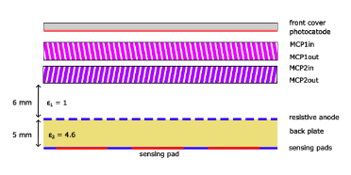
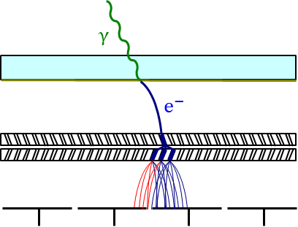
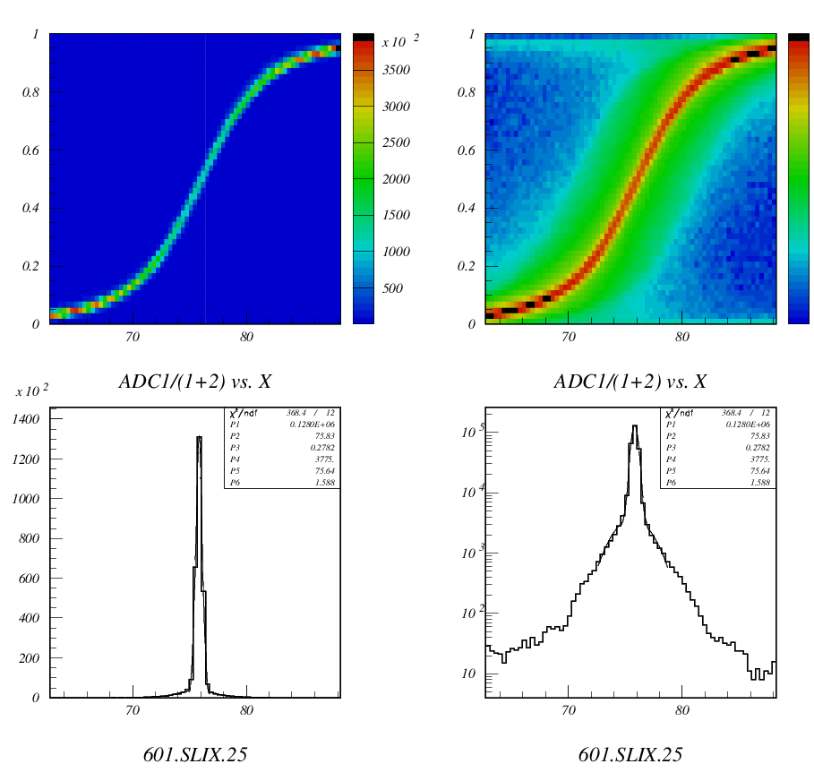
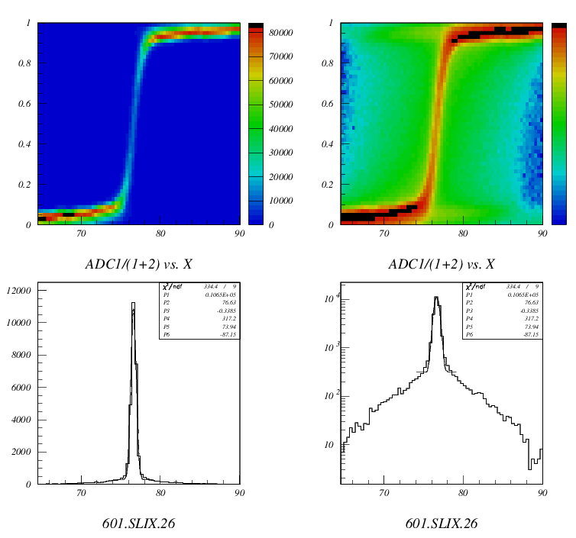
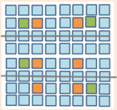
MCP PMT readout: capacitive coupling vs. internal anodes
Secondary electrons spread out when traveling from the MCP-out electrode to the anode and can hit more than one anode → Charge sharing
LAPPD (capacitive coupling through the backplane)
BURLE/Photonis PLANACON (internal anodes)
Fraction of charge detected by the right pad as a function of red laser spot position
mm
mm
Capacitive coupling vs. internal anodes: signal spread comparison for two MCP PMTs with the same pad size, same range: charge sharing is more effective for capacitive coupling (spreads over larger area).
Advantage or not? Depends on the usage
mm
mm
mm
mm
mm

Slide 14
MCP PMT readout: capacitive coupling, modeling
LAPPD charge sharing
S. Korpar, DRD4 Coll. Meeting April 2025, to be published

Slide 15
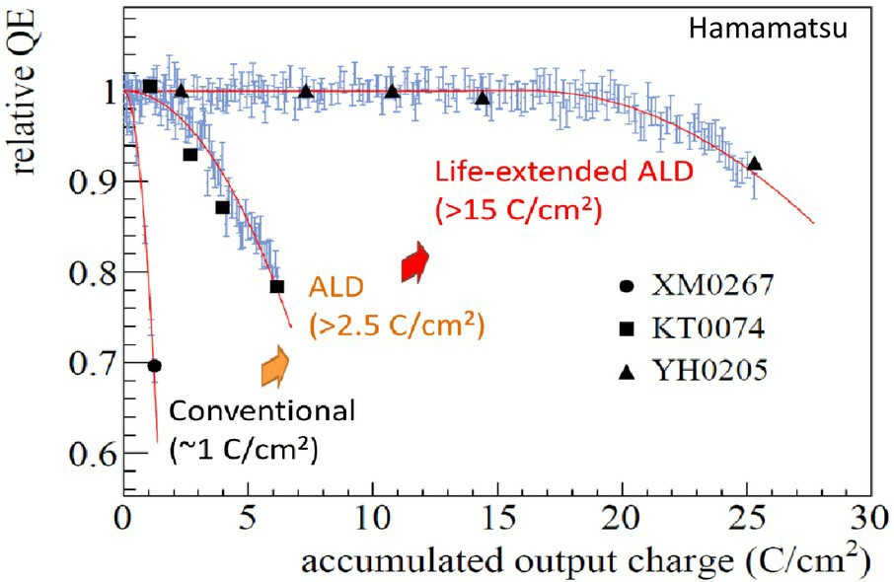
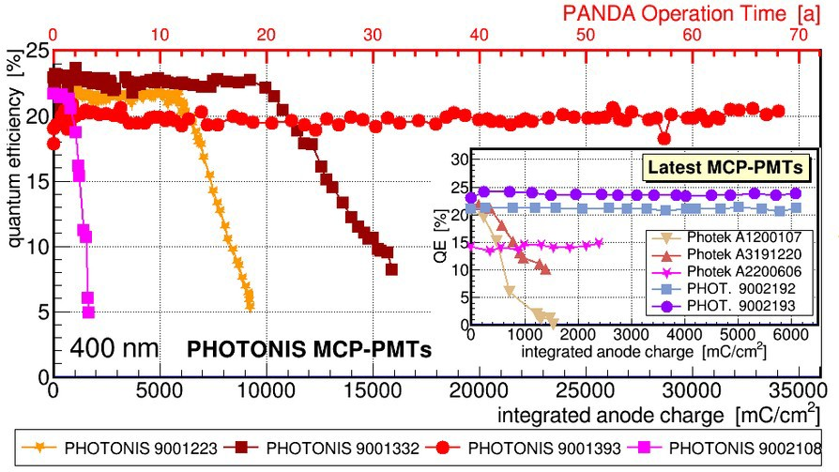
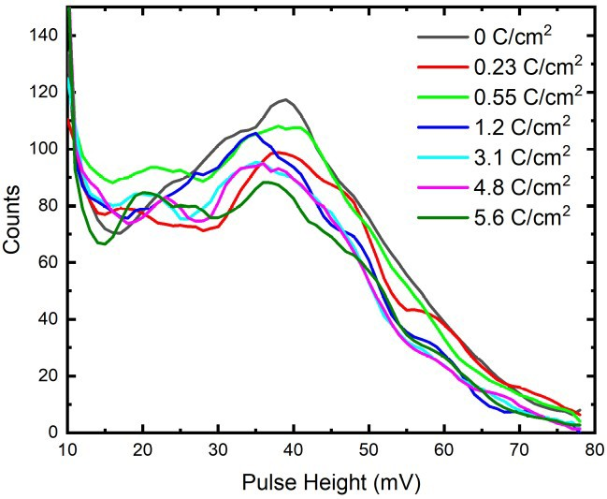
MCP PMT ageing
MCP PMTs: photo-cathode degradation due to ion feedback, main concern in high intensity experiments
ALD (atomic layer deposition) coating of MCP pores → ~100x photo-cathode lifetime increase
Hamamatsu 1-inch YH0205 (>20 C/cm²) [K. Inami, 2021]
No QE degradation for Photonis MCP-PMT (R2D2) to >34 C/cm²
Little QE degradation in LAPPD 8-inch up to 5.6 C/cm² [V. A. Chirayath, CPAD2021]
K. Inami, 2021, Talk at ECFA TF4 Symposium
A. Lehman et al.,
https://arxiv.org/abs/2403.13938
V.A. Chirayath et al., Talk at CPAD 2021
LAPPD-64

Slide 16
MCP PMTs: high rate operation
  High rate performance studies
A. Lehman et al.,
https://arxiv.org/abs/2403.169536

Slide 17
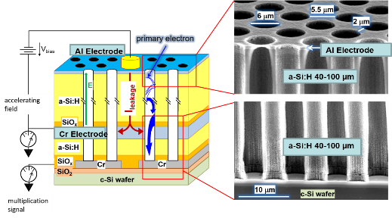
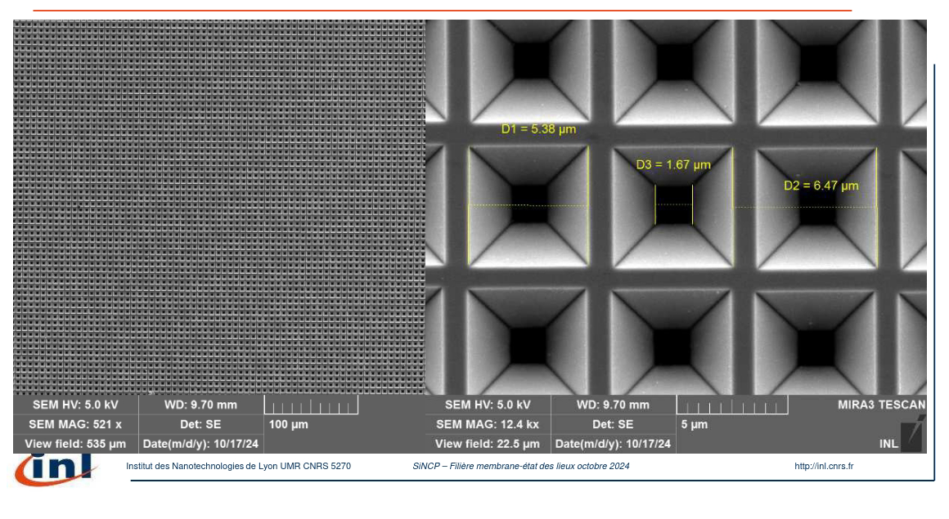
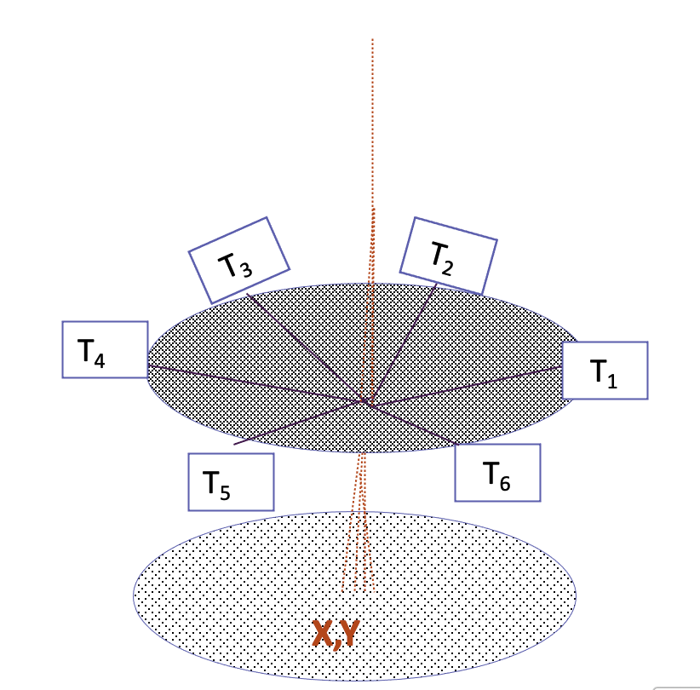
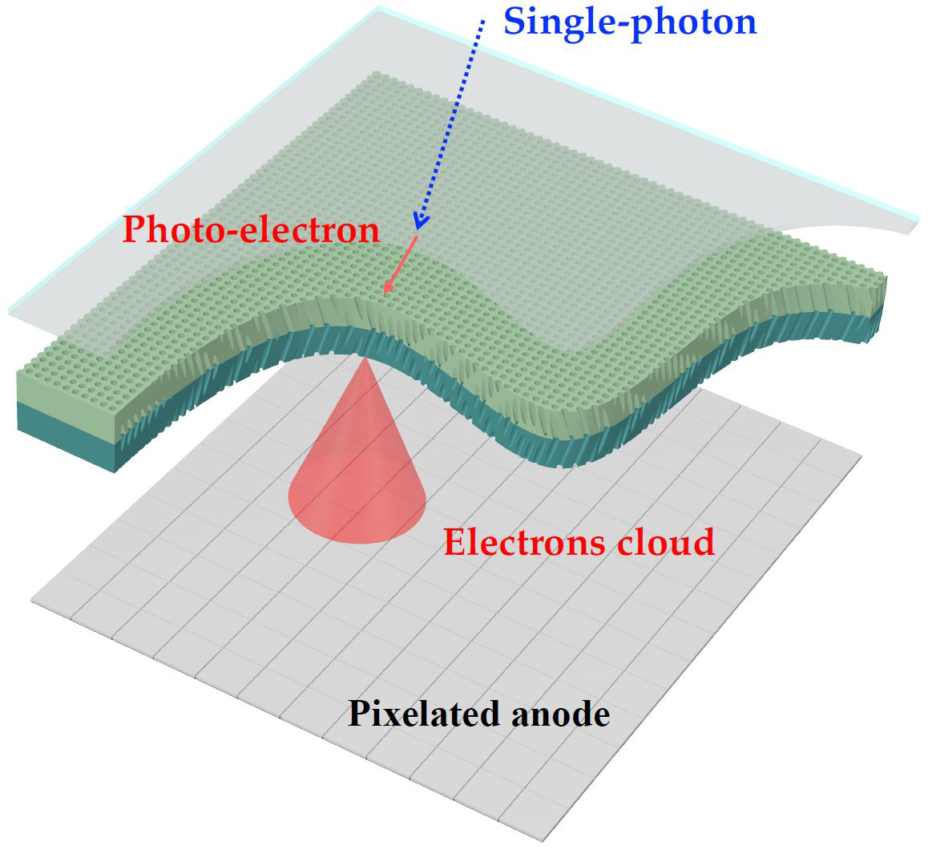
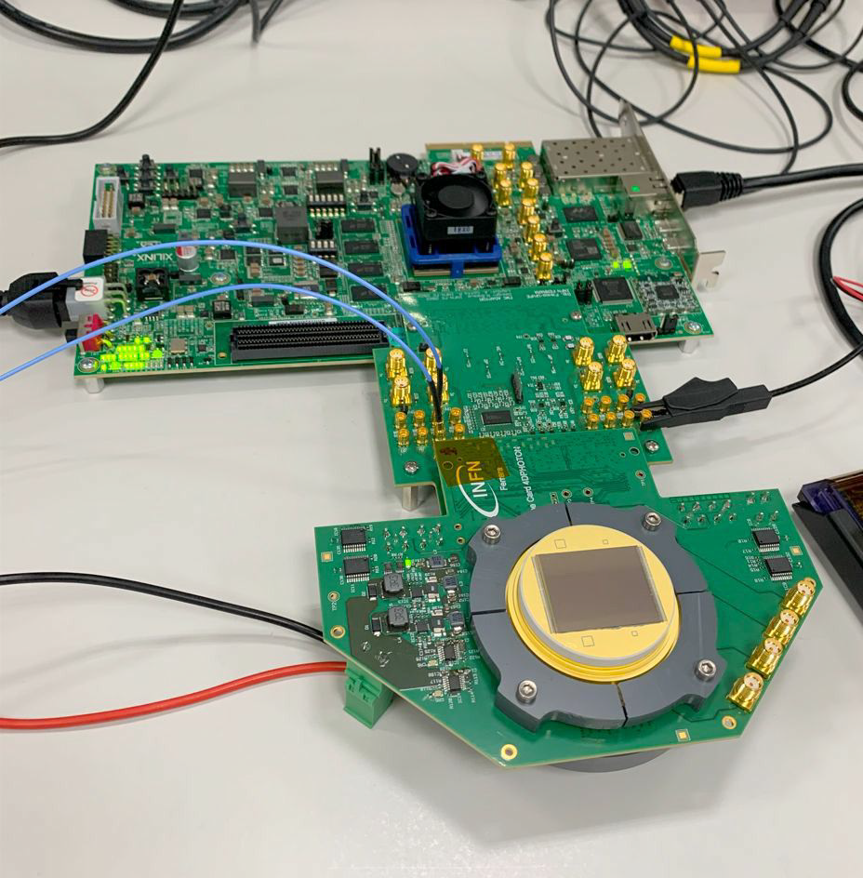
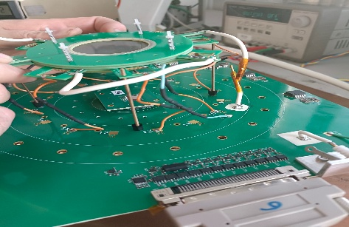
MCP-PMTs: New materials and read-out options
4.2.1: VPD: New material, new coatings, longevity and rate capability study
  This concerns the R&D on new materials to produce VPD,
  new shapes and new coatings and their consequences
  on their longevity and rate capability
4.2.2: VPD-PMT: New photocathode materials, structure and high quantum efficiency VPD
  New photocathode materials, new structures and their impact on improving
  the quantum efficiency for different wavelengths
4.2.3: VPD time and spatial resolution performance
  Study of VPD timing and spatial performance using appropriate readout electronics and appropriate anode structures
[1] A. Franco et al. Sci. Rep. 1 (2014).
Amorphous Si MCPC(Geneva)
Si nanometric structure for
reflective photocathode (Lyon)
time
Woven strips
MCP+Timepix4 (Ferrara)
MCP+PICMIC concept (Lyon)

Slide 18
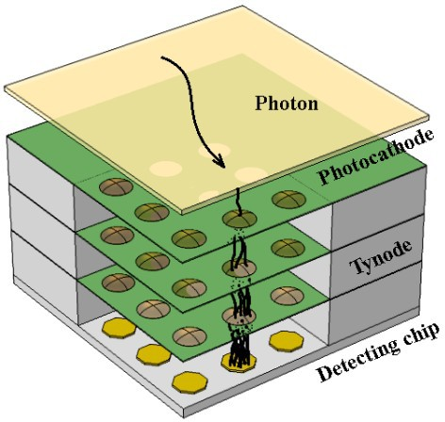
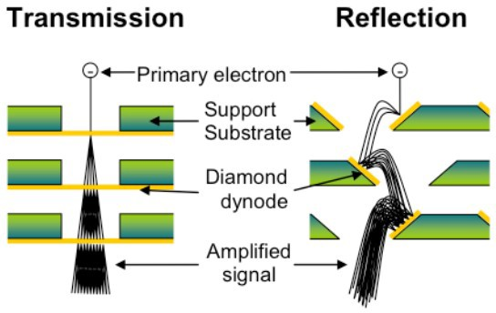
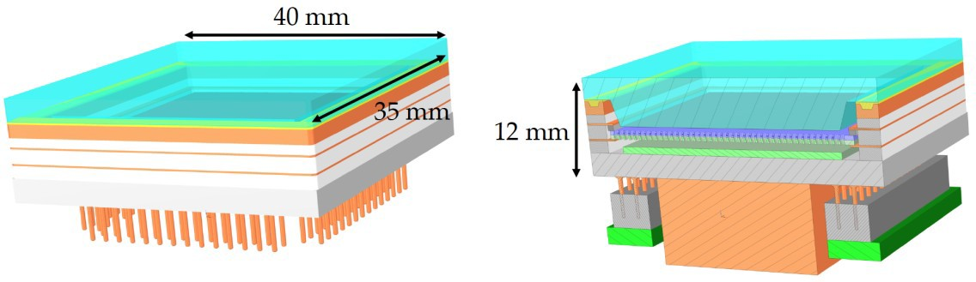
Possible Future of Electron Multiplication
Tynodes (→ Time Photon Counter)
Transmission mode dynode → tynode
Fabrication of tynodes (MgO ALD, diamond) using MEMS technology
“Anode” is a CMOS chip (e.g., TimePix) Very promising properties
Very compact; high B-field tolerance; very fast
H. van der Graaf et al., NIM A847 (2017) 148
Very low DCR; very good 2D spatial resolution
MCP-PMT with CMOS anode
Conceptual design for 4D detection of single photons
Hybrid concept: MCP-PMT where the pixelated anode is an
ASIC (CMOS) embedded inside the vacuum
Prototype with Timepix4 ASIC as anode (array of 23k pixels)
M. Fiorini, RICH2022
Envisaged performance
<100 ps time resolution and 5-10 μm spatial resolution
Rate capability of >100 MHz/cm² (<2.5 Ghits/s @ 7 cm² area)
Low gain (~10⁴) operation possible → x100 lifetime increase

Slide 19
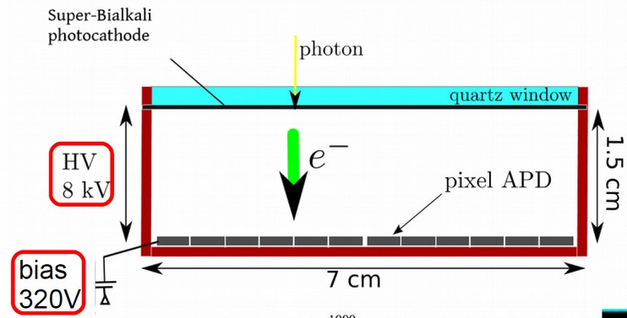
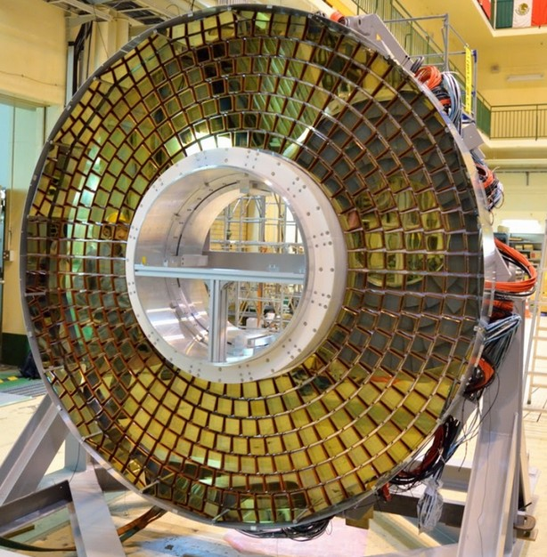
Hybrid photodetectors (HPD, HAPD)
Focusing and proximity focusing configurations
Photo-electron acceleration in a static electric field (8kV to 25 kV)
Photo-electron detection with
Segmented PIN diode (HPD)
Avalanche photo diode (HAPD)
Silicon photomultiplier (VSiPMT)
Employed on a large scale:
HPD: RICH1+RICH2 of LHCb (Run 1+2), CMS HCAL
HAPD: Aerogel RICH detector of Belle II

Slide 20
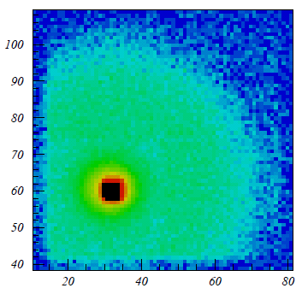

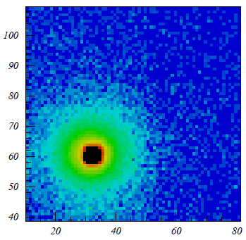

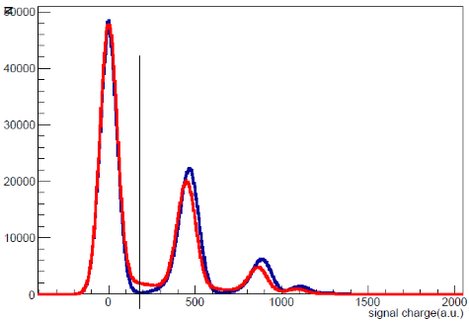
HAPD: photoelectron backscattering in magnetic field
0 T
around 20% of photoelectrons back-scatter and the maximum range is twice the distance from photocathode to APD ~40mm
in a strong magnetic field (perp. to the HAPD window) scattered photoelectrons follow magnetic field lines and fall back to the same pad
photoelectron energy is deposited at the same pad
1.5 T
-- 0 T
-- 1.5 T

Slide 21
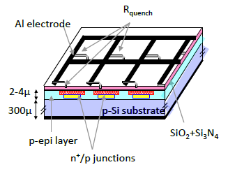
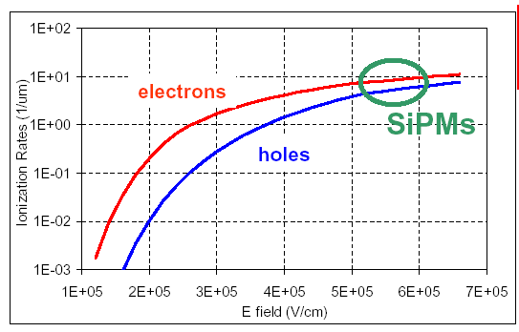
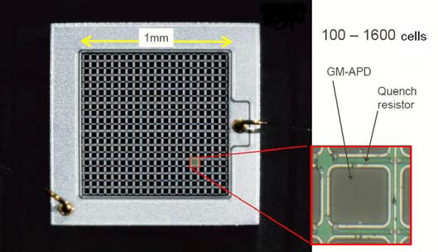
Solid state low light level photosensors:
Silicon photomultipliers SiPM
An array of APDs operated in Geiger mode – above APD breakdown voltage (microcells or SPADs – single photon avalanche diodes)
Detection of photons:
absorbed photon generates an electron-hole pair
an avalanche is triggered by the carrier in the high field region → signal
voltage drops below breakdown and avalanche is quenched (passive or active quenching)
each triggered microcell contributes the same amount of charge to the signal

Slide 22
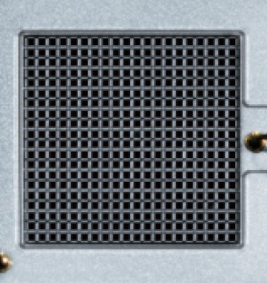
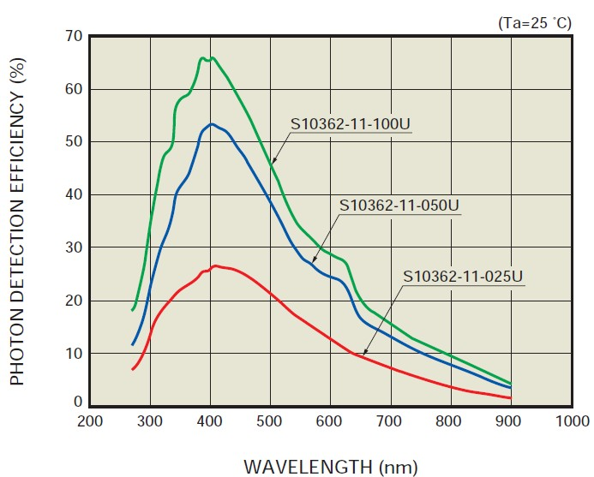
SiPMs as single photon detectors
SiPM as low-light-level sensors.
Characteristics:
low operation voltage ~ 10-100 V
gain ~ 10⁶
peak PDE up to 65%(@400nm)
PDE = QE x ε_{geiger} x ε_{geo} (up to 5x PMT!)
ε_{geo} – dead space between the cells
time resolution ~ 100 ps
works in high magnetic field
dark counts ~ few 100 kHz/mm²
radiation damage (p,n)
*PDE = photon detection efficiency
few mm
  100U
  050U
  025U

Slide 23
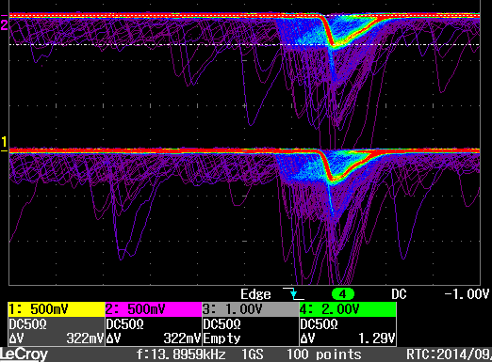
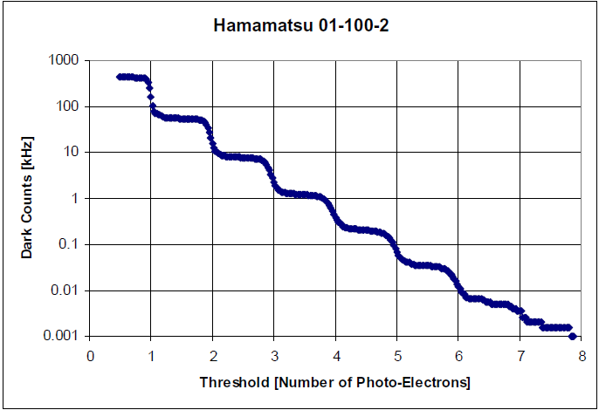


SiPM: noise
dark counts are produced by thermal generation
of carriers, trap assisted tunnelling or band gap tunnelling
signal equal to single photon response
typical rate went from $≈1MHz/mm^{2}$ for early attempts to below $100kHz/mm^{2}$ for more recent devices
roughly halved for every -$8^{o}C$
increases linearly with fluence
optical cross-talk produced when photons emitted in avalanche initiate signal in neighbouring cell, reduced by screening – trenches
after-pulses produced by trap-release of carriers or delayed arrival of optically induced carrier in the same cell
A. Gola et al. Sensors 19(2019)308

Slide 24




SiPM: parameter correlation
Higher overvoltage:
higher field:
  higher avalanche trigger probability → higher PDE
  faster signal → better timing
higher gain:
  better signal to noise (electronic)
  more optical cross-talk → higher ENF, worse timing
  more after-pulses
A. Gola et al. Sensors 19(2019)308

Slide 25



VUV SiPM for cryogenic applications
LAr, LXe applications:
VUV sensitivity required:
  128 nm (LAr), 178 nm (LXe)
  optimization of anti-reflective coating ARC
  PDE $≈20 \%$
cryogenic temperatures:
  low DCR $≈10mHz/mm^{2}$ dominated by band-band tunnelling, reduced by low-field avalanche region
  higher after-pulse rate $≈10\%$
A. Gola et al. Sensors 19(2019)308
A. Jamil et al. IEEE TNS 65-11(2018)2823

Slide 26

SiPM: single photon timing
Intrinsic TTS of SiPM microcells is extremely fast,
$<20 ps$ for single microcells (SPAD), but timing deteriorates for larger devices. The main contributions:
nonuniformity within microcell (edges)
spread between microcells
overall SiPM capacitance
$λ$ dependence - tails
Comparison of timing properties for single $50μm$ SPAD, $1×1 mm^{2}$ and $3×3 mm^{2}$ SiPMs with the same SPAD for microcells:
  timing improves with higher overvoltage – larger pulses, at the expense of increased SiPM noise
  best timing resolutions for single cell signals are $σ≈21 ps, 32 ps \text{and} 77 ps$
  TTS deterioration mainly due to a larger overall capacitance → reduced signal slope, $σ_{t}≈σ_{el.}{\left(\frac{dU}{dt}\right)}^{−1}$
F. Acerbi et al. IEEE TNS 61(2014)2678

Slide 27



SiPM: timing variation
Variation of TTS over the device surface can contribute to overall time spread:
  variation within micro-cell
  variation for different micro-cells
.
KETEK PM3375TS-SBO (early design)
S. Korpar et al. @IEEE 2015
F. Acerbi et al. NIM A926(2019)16
0.3 mm
2.5 mm
FBK: Masking of outer regions of micro-cells: Improve signal peaking and mask areas of micro-cell with worse timing

Slide 28

SiPM: timing for multi-cell signals
Optical cross-talk contribution to multi-cell signals spoils timing distribution – does not scale with $\frac{1}{N^{1/2}}$:
two components for 2-micro-cell signals:
  double photon events – proper scaling
  single photon with cross-talk, timing somewhere between single and double micro-cell signals and resolution is worse
ratio between contributions changes with light intensity confirming optical cross-talk origin
even more components for multi-micro-cell signals
F. Acerbi et al. IEEE TNS 61(2014)2678

Slide 29


SiPM: timing test with pico-second laser
AdvanSiD SiPM ASD-NUV3S-P-40
OV=6V, T=-25^{o C}
blue laser λ =408nm, ~ 35ps FWHM
R. Dolenec et al. NIM A876(2017)257

Slide 30


Reduction of optical crosstalk
Starting from the NUV-HD technology, FBK and Broadcom jointly developed the NUV-HD-MT technology, adding metal-filled deep trench isolation to strongly suppress optical crosstalk.
Other changes: low electric field variant, layout optimized for timing.
Microcell (SPAD) of SiPM
Metal
Connections
Quenching resistor
High-field region
> 10x
reduction
~ few µm
Metal-filled DTI
Conceptual drawing of the NUV-HD-MT, with the addition of metal-filled Deep Trench Isolation.
Reduction of optical crosstalk probability in NUV-HD-MT, compared to the “standard” NUV-HD. Measurement without encapsulation resin, i.e. only considering internal crosstalk probability.
A. Gola, talk at RICH2022

Slide 31



Backside illuminated SiPMs
Backside illuminated (BSI) SiPMs:
potential for an enhanced PDE and a better radiation tolerance.
The first results of the FBK IBIS Run samples

Slide 32







Ultragranular SiPMs with integrated electronics
Timing of SSPD & Developing ultra-granular SiPM that integrates with the readout electronics
3x3 mm² SiPM array
FastIC+
(collab. CERN ICCUB)
Low power
Chip
2024 Produced and evaluated
design & production 6.2025
256 Ch 5x5cm²
Module proposal
Ultra granular SiPMs
Long term goal 1x1mm2 SiPM array

Slide 33



SiMs: SPAD with micro-lenses
CMOS-SPAD light sensors: co-integration of SPADs and electronics, digitised output signals
spadRICH - Radiation-hard digital analog silicon photomultipliers for future upgrades of Ring Imaging Cherenkov detectors

Slide 34

Light concentrators
At the device level (lenses, Winston cones):
reduce active are – reduce DCR (tolerate higher fluences)
use smaller faster devices
At the micro-cell level (micro-lenses, diffractive lenses, meta lenses):
compensate for low fill factor – small cells, dSiPM
concentrate light in cell centre – better timing
Higher concentration – narrower angular acceptance
Imaging light concentrators:
smaller photon impact angles on the sensor
can be used with position-sensitive arrays
Non-imaging light concentrators:
larger photon impact angles on the sensor – directly coupled to the sensor

Slide 35





SiPM RICH with light concentrators
RICH photon detector module prototype:
Hamamatsu 64 channel MPPC module S11834-3388DF, $8×8$array of $3×3 mm^{2}$ SiPMs @ $5 mm$ pitch
matching array of quartz light concentrators used
two $20 mm$ thick aerogel tiles in focusing configuration ($n=1.045, 1.055$)
tested in $5 GeV$ electron beam at DESY
E. Tahirović et al., NIM A787 (2015) 203

Slide 36


Microlenses for light collection
Micro-lens array coupled to SPAD array
CMOS SPAD array, 128x128 $6μm$ diameter @$25 μm$ pitch – 5% fill factor
matching polymer plano-convex micro-lens array
J.M. Pavia et al. Opt.Exp. 22-4(2014)4202

Slide 37
Microlenses for light collection 2
Increase the active area fraction – use microlenses
G. Haefeli et al., TNS, DOI 10.1109/TNS.2025.3542597

Slide 38

SiPMs: Radiation damage
Show stopper at fluences above ~10¹¹ in case single (or few) photon sensitivity is required!
(e.g. expected fluence in the ARICH area of Belle II: 2-20 10¹¹ n cm⁻² )
Waveforms from irradiated SiPMs
Use of wave-form sampling readout electronics
Operating the SiPMs at lower temperature
Annealing periodically (annealing at elevated temperature is preferred)
Reducing recovery time to lower cell occupancy
→ Radiation resistant SiPMs, other materials?

Slide 39



SiPMs: Radiation damage
A. Gola, RICH2022
Beyond 10⁷÷10⁸ n_{eq}/cm² little correlation between the DCR before and after irradiation:
All technologies seem to “converge” towards similar values
Independence of bulk damage from contaminants in the SiPM starting material?
V_{OV} = 3 V
DCR (dark count rate) vs fluence
Room temperature annealing (20-25°C) for samples irradiated to 6.4∙10¹¹ 1 MeV n_{eq}/cm²
Little effect, knee point at around 1.5·10³ min (~1 day)
A. Gola, RICH2022

Slide 40
SiPMs: Radiation damage, annealing at elevated temperatures
Dark counts at -30C of a Hamamatsu S13360-1350CS SiPMs: non irradiated (blue) and irradiated up to 10¹¹ (yellow), 10¹² (green) and 10¹³ (orange) n_{eq}/cm²
annealing
M. Calvi et al., NIMA 922 (2019) 243-249

Slide 41


SiPMs: radiation damage, mitigation
Operation of highly irradiated SiPMs for single photon detection – cooling and annealing
Annealing
Cooling: Temperature at which the SiPMs are ”usable” for single-photon detection, i.e. where the single photo electron peak @ 9V over-voltage is separated from the background.
EIC dRICH
Upg ~2031
Belle II ARICH
Upg ~2032
LHCb RICH Upg II -2034
R. Preghenella, PD24
D. Consuegra-Rodrigez et al., Eur. Phys. J. C 84, 970 (2024)

Slide 42

SiPMs: Radiation damage, annealing at elevated temperatures
M. Calvi et al., NIMA 922 (2019) 243-249
DCR at 77 K versus neutron fluence
Blue circles: annealed sample
→ Annealing helps also at 77 K

Slide 43

SiPMs: radiation damage, mitigation
Fast & radiation hard SiPMs - enabling the use of SiPM in highly irradiated areas
Experimental structures, AidaInnova Run – exp. May 2025
Two different technologies:
  Low electric field
  Ultra Low electric field
Cell pitch: 15, 25, 40, 75um; SiPM sizes: (0.25, 0.5,1,2,3)² mm²

Slide 44

New materials
new higher band gap materials - possibly lower DCR - higher radiation resistance, higher temperature
(V)UV sensitive
high dark count rate – dominated by trap assisted tunnelling
4H-SiC:
$E_{g}=3.26 eV$
PDE $≈10\%$
DCR $> 1 MHz/mm^{2}$
nonuniform response
L. Su et al. J. Semicond. 40(2019)121802

Slide 45

Gas based photon detectors
Standard photosensitive substance: CsI evaporated on one of the cathodes.
Large scale application: ~11 m² ALICE RICH

Slide 46
Gas based photon detectors: recent developments
Instead of MWPC:
Use chambers with multiple GEM or thick GEM (THGEM) gas amplification stages with transm. or refl. photocathode
COMPASS RICH: trans. photocathode and 2x THGEM + MicroMegas
Ion damage of the photocathode:
blocking ions – non-aligned GEM holes
New developments:
Smaller pads
Novel photocathode material: nano-diamond layer
S. Dalla Torre, NIM A 970 (2020) 163768

Slide 47
Summary and outlook
Next generation of experiments in particle physics: photosensors with faster timing, wider spectral range and improved radiation tolerance.
Many new interesting developments are underway, in particular in SiPMs and MCP-PMTs – not all of them could be covered in this talk.
A detector R&D collaboration (DRD4) was set up early in 2024 to facilitate collaboration in this area of research

Slide 48
Back-up slides

Slide 49
ECFA Detector R&D Roadmap
The ECFA Detector R&D Roadmap, developed following the 2020 European Strategy for Particle Physics, outlines a long-term vision to advance detector technologies critical for future particle physics experiments.
It emphasizes strategic planning and investment in areas like
sensor development (gaseous, liquid, solid-state),
photon detection,
quantum sensing,
calorimetry, and
integrated electronics.
The roadmap highlights the need for coordinated European efforts, robust infrastructure, training, and industrial partnerships.
Strategic recommendations address challenges such as rising R&D costs, sustainability, and the retention of expert talent to ensure Europe remains a global leader in detector innovation.
It also provides a list of detector research and development themes - DRDTs

Slide 50

Detector research and development themes (DRDTs)

Slide 51
ECFA Detector R&D Roadmap implementation:
Detector R&D (DRD) Collaborations
1. Gaseous
2. Liquid
3. Semiconductor
e.g.
CMOS pixel sensors;
4. PID & Photon
e.g.
spectral range
of photon sensors;
e.g. time/spatial resolution;
e.g. Light/charge readout;
low background materials
environment friendly gases
High time resolution
(10s ps)
Time resolution
5. Quantum
6. Calorimetry
7. Electronics
8. Integration
quantum sensors
- R&D, incl. beyond QFTP in conventional
detectors
e.g. Sandwich; noble liquid; optical
e.g. ASICs; FPGAs; DAQ
tracking detector mechanics
Chris Parkes, IOP APP+HEPP+NP Conference, April 2024

Slide 52

DRD4: photon detectors and PID
Detector R&D Themes (DRDTs)
  Single-photon sensitive photodetectors (vacuum, solid state, hybrid)
  PID techniques (Cherenkov-based, Time of Flight)
  Scintillating Fiber (SciFi) tracking
  Transition Radiation (TR) using solid state X-ray detectors

Slide 53

DRD4 : photon detectors and PID
Organization:
Work packages: projects
Working groups: discussion forums

Slide 54
DRD4:WP4.1 Solid-State Photodetectors
◼ Task 1 -SSPD with new configurations and modes: Development of back-side illuminated SiPM (potential for better PDE and radiation tolerance); development of ultra-granular SiPM that integrates with the electronics by using 2.5D or 3D interconnection techniques; development of CMOS-SPAD light monolithic sensors for HEP; study of new materials for light detection
◼ Task 2 -Fast radiation hard SiPMs: Standardize procedures for quantification of radiation effects; irradiated SiPMs characterization in wide temperatures range (down to -200 ˚C); study of annealing; study and quantify other measures enabling the use of SiPM in highly irradiated areas (e.g. smaller SiPMs, macro-and micro-light collectors)
◼ Task 3 -Timing of SSPD, including readout electronics: Study and improve the timing of SiPMs; co-design of a multi-ch. readout ASIC exploiting the timing potential; integration and packaging with integrated cooling; vertical integration of SiPM arrays to FEE (better timing via reduction of interconnections' parasitic induct+capac)
Long term goal 1x1mm2 SiPM array

Slide 55
DRD4:WP4.2 Vacuum-based Photodetectors
◼Task 1 -New materials, coatings, longevity and rate capability studies: Develop new materials and techniques to increase MCP-PMT tube lifetime and improve rate capabilities; use new techniques with new materials to achieve high aspect ratio with small diameter for better gain, time, and spatial resolution
◼Task 2 -New photocathode materials, structure and high QE VPD: Search for new materials with the required characteristics to be used as photocathodes; develop photocathodes with new structures
◼Task 3 -VPD time and spatial resolution performance: Development of large area MCP-based photodetector with combined excellent timing and position resolution, including electronics integration

Slide 56



Rate Capability
A. Lehmann, RICH2022
MaPMT
MaPMT R13742: no gain loss to up 10 MHz/mm²
MCP-PMTs
Gain decreases at high photon rates
2-inch MCP-PMTs: ~1 MHz/cm² (with 10⁶ gain)
1-inch Hamamatsu R10754 PMTs: ≥10 MHz/cm²
8-inch LAPPD-64: ~100 kHz at 4.6 mm Ø laser spot
M. Calvi et al., JINST 15 (2020) P10031
R10754 MCP-PMT
Improving the rate capability in MCP-PMTs
Lower MCP resistance (ranging at tens of MΩ)
Lower capacitance - subdivision of MCP layers into smaller partial areas; the second MCP layer was divided in the previous version of Hamamatsu tubes
Low gain operation (for single photon detection) - may be possible with amplifiers included directly in the anode (e.g., monolithic or CMOS designs)
V.A. Chirayath et al., Talk at CPAD 2021
LAPPD-64

Slide 57




Radiation Tolerance
MaPMT
Recently tested for CBM (H12700 and H8500) Irradiation dose up to 3x10¹¹ n/cm² and 150 Gy gammas Few kHz increase of DCR but recovers after few months
UV glass: 1-2% transmission loss @ 400 nm up to 1 kGy No negative effects on gain and pulse height spectrum Neutron activation of Kovar metal alloy is a minor effect
H(A)PD
Radiation tolerance dominated by silicon detector Intensively studied for 144ch HAPD for ARICH @Belle II
Basically no QE loss at 5x10¹¹ n/cm²
Increase of APD leakage current leads to significantly worse S/N ratio: ~17 before, ~3 after irradiation
S/N ratio partly regained by adjusted readout parameters
C. Pauly et al., NIM A1040 (2022) 167177
.S. Shiizuka, Talk at VCI 2010
Pulse height dist.
after 5x10¹¹ n/cm²
MCP-PMT
Entrance window: should be similar to other PMTs
MCPs: currently no data
Pulse height dist.
after 5x10¹¹ n/cm²
+ adjusted readout
I. Adachi, NIM A639 (2011) 103

Slide 58
















SiPM: p-on-n vs. n-on-p
n-on-p: green/red light sensitive:
electrons drift to Geiger region from substrate and holes from surface side
higher dark count rate – most of the thermally generated carriers arriving to Geiger region are electrons
p on n - green/blue light sensitive:
electrons drift to Geiger region from surface and holes from substrate side
lover dark count rate – most of the thermally generated carriers arriving to the Geiger region are holes
J. Musienko@PD07
holes
electrons
electrons
holes
A. Gola et al. Sensors 19(2019)308

